Slide 1

CS50 – FINAL PROJECT
Kaggle Competition
House Prices: Advanced Regression Techniques

Slide 2
Intro
Project Name:
Kaggle Competition House Prices: Advanced Regression Techniques
Name: Omar Mohamed Elbasha
GitHub: Omar-Elbasha
EDX: OmarElbasha
City: Cairo, Egypt – currently in Dubai, United Arab Emirates
Date: 21/11/2024

Slide 3
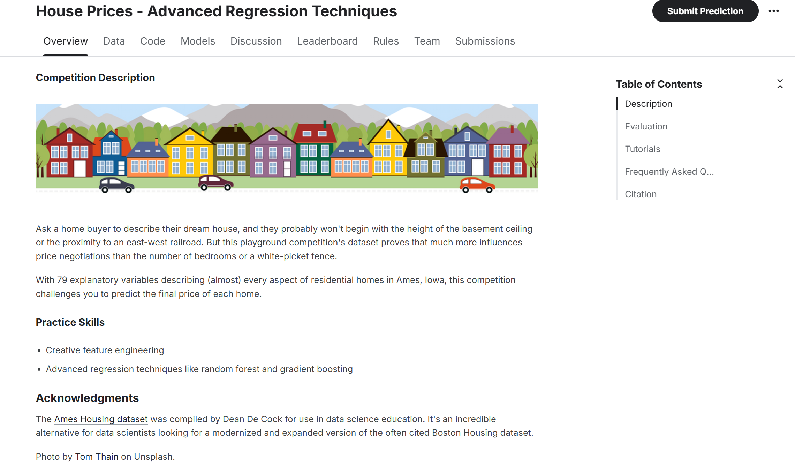

Slide 4
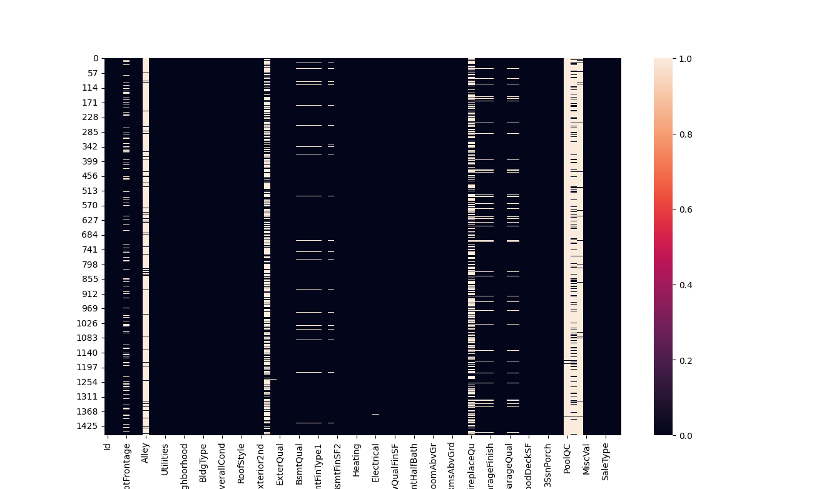
Missing Values

Slide 5
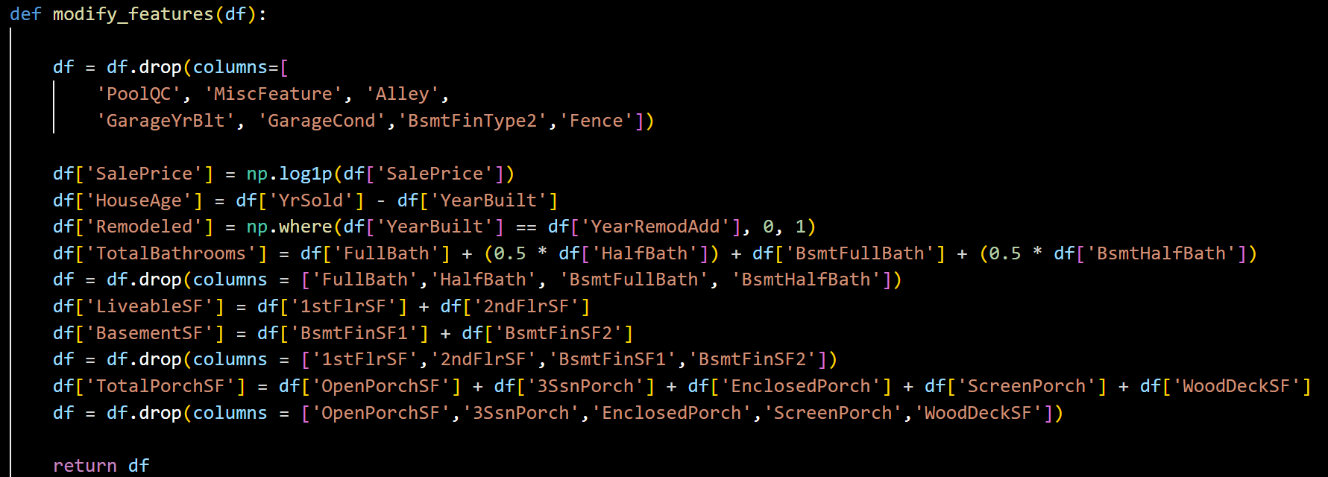
Feature Engineering

Slide 6
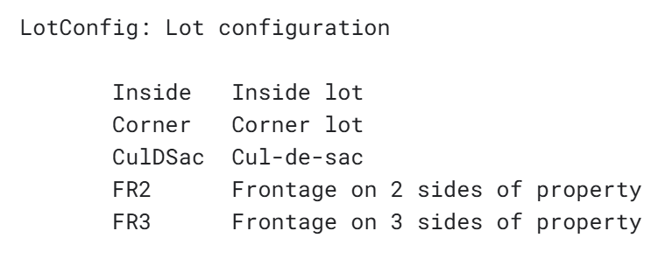
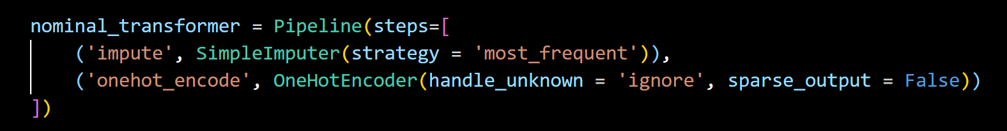
Nominal Data

Slide 7
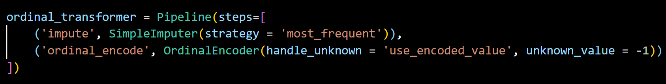
Ordinal Data

Slide 8
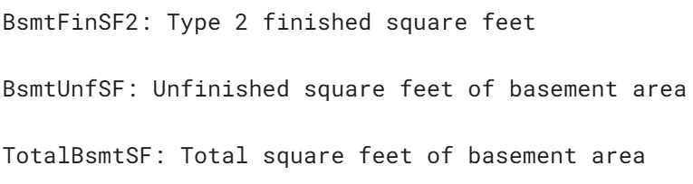
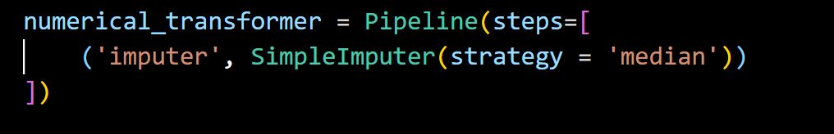
Numerical Data

Slide 9
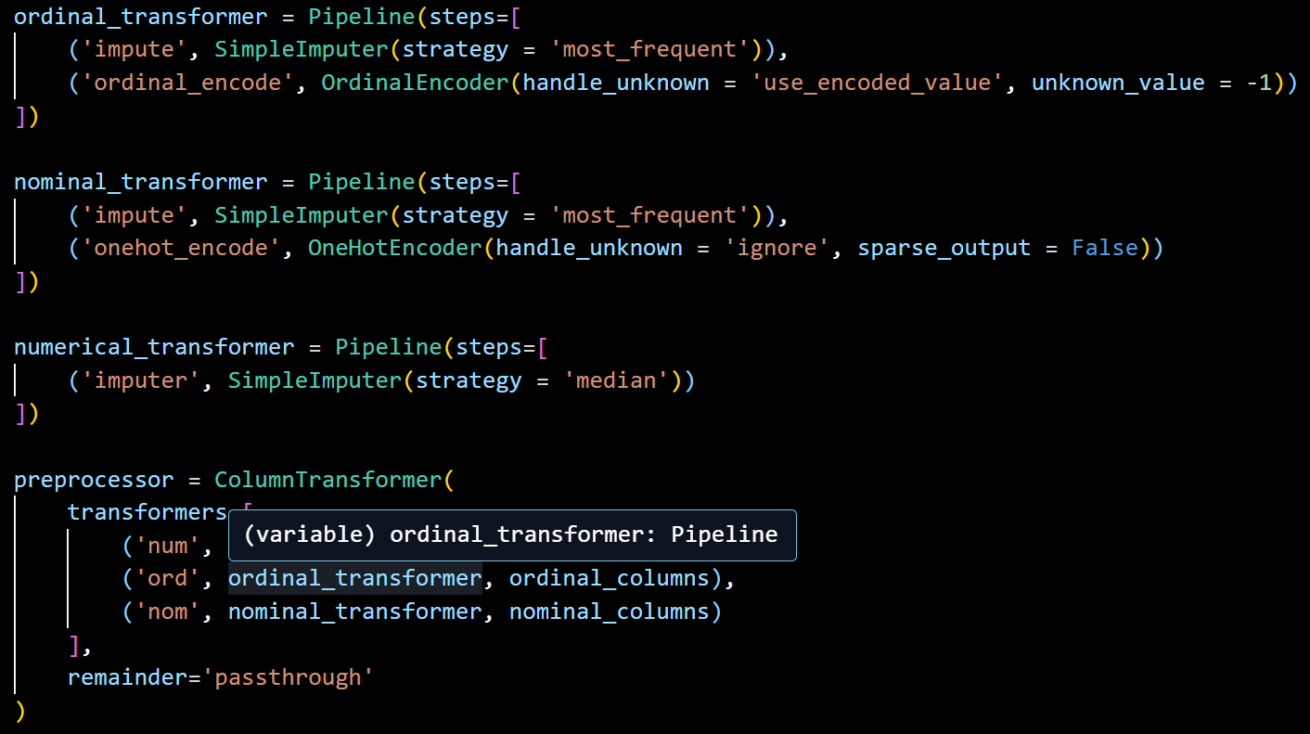
Model

Slide 10
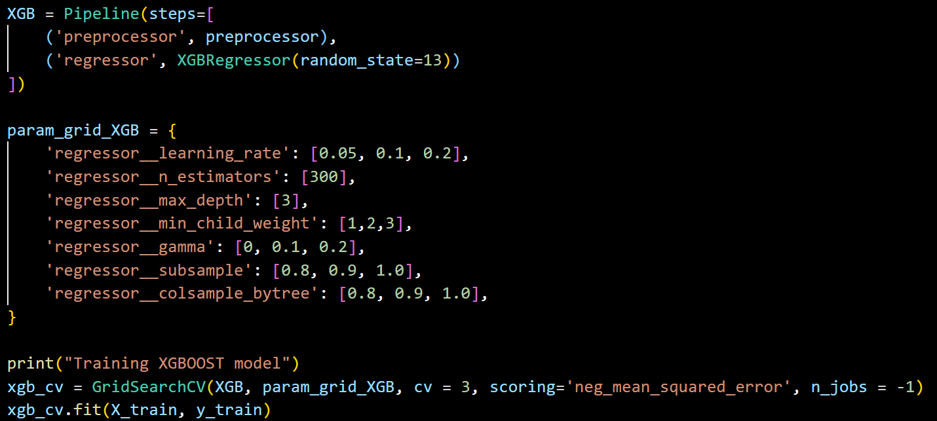
Model

Slide 11
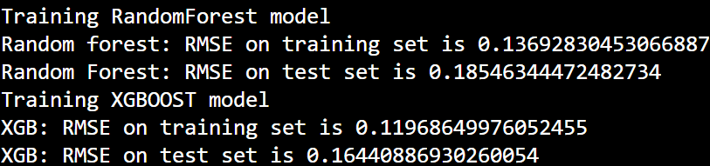
Training results
XGBoost performed significantly better

Slide 12
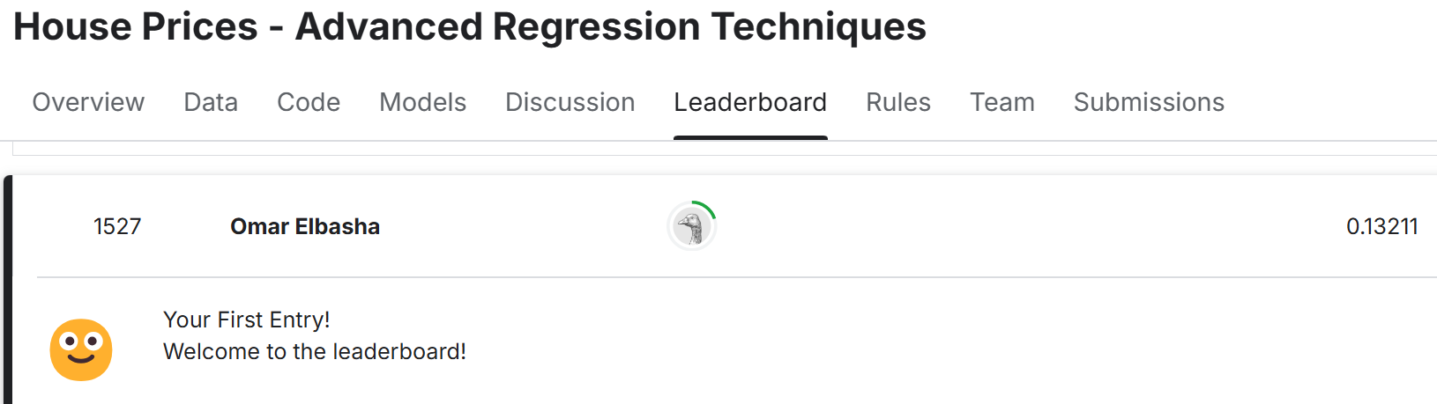
Kaggle Submission
Leaderboard: top 25% - 1527 out of 6060 submissions

Slide 13
Thank you

